Slide 1

DATASET RISK ANALYSIS USING MACHINE LEARNING
PRESENTED BY ESTHER EBERE

Slide 2
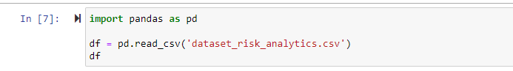
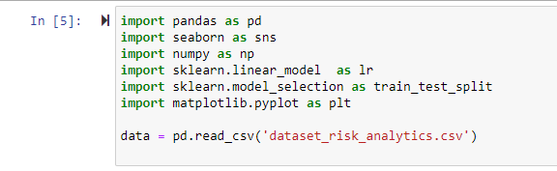
STEP 1- DATA COLLECTION
Machine learning to predict loan using Python
Dataset is imported into Jupyter Notebook
Dataset is in csv format.

Slide 3
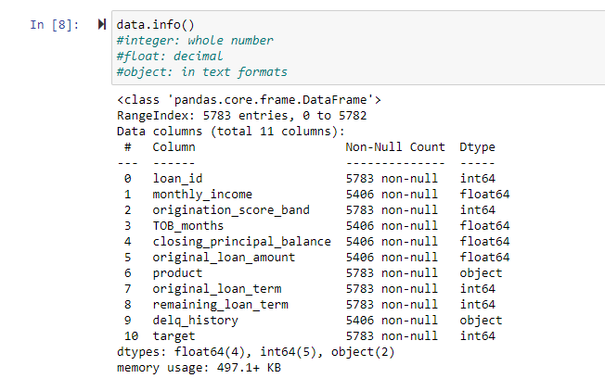
STEP 2- DATA EXPLORATION
Dataset includes a total of 5783 rows and 11 columns
Data Information/types include 4 floats, 5 integers and 2 objects

Slide 4
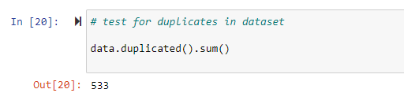
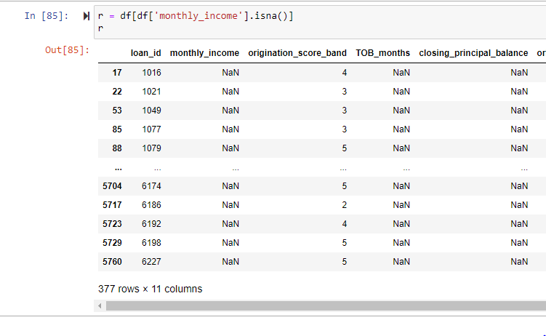
STEP 3: DATA CLEANING
Removed the 533 rows that had duplicated loan_id
Removed the rows containing NaNs for “monthly_income” since this column is an important factor in prediction.
Target is the dependant variable
Looking at the target column to see for how many the loan got rolled and not rolled (not rolled = 3413, rolled = 1460)
Selected attributes include monthly_income, origination_score_band, TOB_Months, closing_principal_balance, original_loan_amount, original_loan_term, remaining_loan_term.

Slide 5
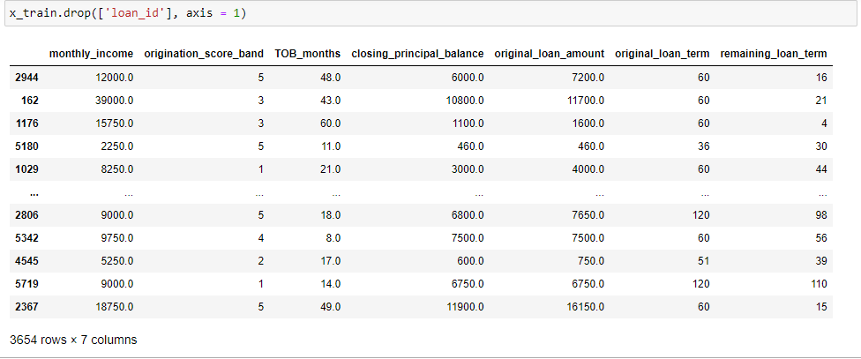
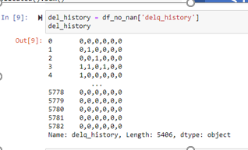
DATA CLEANING
Removed the load_id from the dataset
Removed columns “product” and “delq_history” which their data type wasn’t compatible with the data requirement for selected models.
Notes:
Removed the load_id from the dataset since its not a factor in prediction.

Slide 6
Selected classifiers
Selected the following classifier for model creation:
Support vector machine
Random Forest

Slide 7
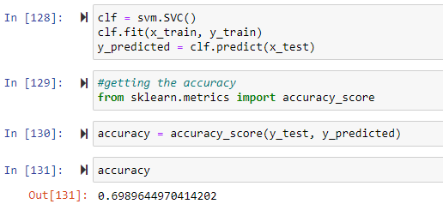
Support Vector Machine - Model efficiency
Used accuracy score to measure the model’s efficiency
Accuracy of the model = 0.700.

Slide 8
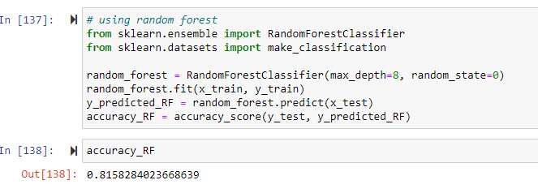
Random Forest
Accuracy = 0.82

Slide 9
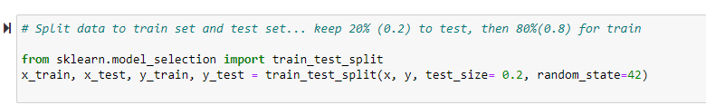
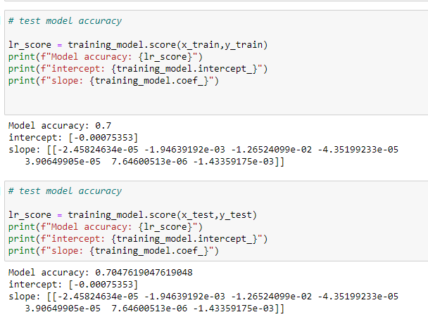
STEP 4: DATA PREPARATION/MODELLING
Split dataset into training and test sets using train_test_split method from sklearn library using ratio 20 to 80 percent.
Testing models for the tests and train(actual and predicted)
Notes:
Split dataset into training and test sets using train_test_split method from sklearn library.
Since we have imbalanced data in terms of target classes we used stratified data split to make sure we have data from both classes in our train and test datasets.

Slide 10
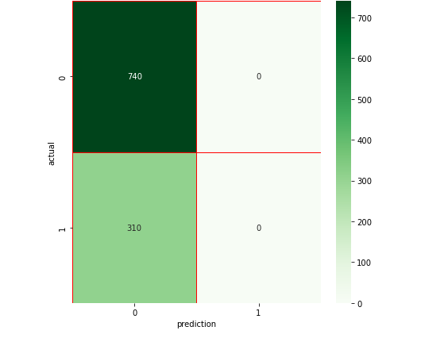
Confusion Matrix
Since accuracy is not always the best metric to measure the model efficiency, confusion matrix was used to measure the accuracy.
Based on the results from confusion matrix 740 was not rolled” or “0”; and 310 “rolled” or “1” class were predicted correctly.

Slide 11
Observation & Conclusion
Observation: the model is predicting the 0 class better and one reason could be that we have more data associated with that class which can affect our model prediction.
The accuracy of the Random Forest was higher than SVM
Y_expected is the target for test data and Y_predicted is the target predicted by our model.
The conclusion from the matrixes ran is that the loan did not roll. This is because the probability of the loan not rolling is twice as much as the loan rolling.
Notes:
The accuracy of the Random Forest was higher than SVM and this model is more efficient in predicting whether the loan should be rolled or not. Here is a screenshot of the test data prediction from Random Forest model.

Slide 12
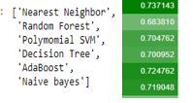
TESTING WITH OTHER CLASSIFERS
MODELS
MODEL SCORES

Slide 13
THANK YOU

